Slide 1

Kubernetes Cybersecurity
Defense System
Notes:
Welcome to our third and final seminar.

Slide 2
Our Team
Mohamed Hassan
01
Mohannad Sabry
02
03
Seif Yasser
Loai Ahmed
04
Ziad Hafez
05
Shimaa Rabia
06

Slide 3
Supervisors
Dr. Mervat El-Qutt
T.A Abdulrahman Ali

Slide 4
Agenda
01
Problem Definition & Proposed Solution
02
Analysis & Design
03
Techniques & Algorithms
04
Experiments, Practical Work & Implementation
05
Problems Faced & Limitations
06
Demo / System Evaluation
07
Conclusion & Lessons Learned
Notes:
Walk through the 7 sections.

Slide 5
1. Problem Definition & Proposed Solution
THE PROBLEM
OUR SOLUTION
Kubernetes environments face sophisticated threats: • SSRF Attacks
• Reconnaissance & network scanning
• Privilege escalation
• Container escapes
Traditional solutions fail:
✗ Reactive — detect after damage
✗ No real-time AI analysis
✗ Manual response — too slow
A real-time, automated defense system detecting 2 attack types: SSRF + Reconnaissance
① Traffic Sniffer (KSniff)
Captures live pod network traffic
② Data Processor (CICFlowMeter)
Converts packets to ML-ready features
③ AI Detector (Naive Bayes)
Multi-class: Benign / SSRF / Recon
④ Mutation Webhook (KubeDeceive)
Intercepts & redirects to honeypot
Notes:
Key upgrade from Seminar 2: our model now detects 2 attack types (SSRF + Reconnaissance), and we replaced the Python controller with a Mutation Webhook.

Slide 6





2. Analysis & Design
KSniff
Traffic Capture
CICFlowMeter
Feature Extraction
Naive Bayes
AI Detection
Mutation
Webhook
Honeypot
Decoy System
▶
▶
▶
▶
⚡ Upgrade from Seminar 2: Security Controller → Mutation Webhook | 1 attack type → 2 attack types (SSRF + Reconnaissance)
Functional
Capture traffic · Extract 80+ features · Multi-class AI (Benign/SSRF/Recon) · Webhook intercept · Honeypot redirect · Dashboard
Non-Functional
Low latency (<2s) · High availability · Scalable pods · Isolated namespaces · RBAC security
Environment
Kubernetes KIND multi-node cluster · Shared PVC storage · Isolated namespaces (security / production / attacker)
Notes:
Key architecture change: the Python Security Controller is replaced by a Kubernetes Mutation Webhook (KubeDeceive). Also, AI now classifies 3 classes: Benign, SSRF, Reconnaissance.

Slide 7
3. Techniques & Algorithms
Gaussian Naive Bayes — Multi-Class Classifier
NEW: Mutation Webhook
• Algorithm: Gaussian Naive Bayes — O(n) efficiency, ideal for real-time classification
Replaces Python Security Controller
Intercepts K8s API requests in-flight
Go server: reject / delay / redirect
TLS-secured Webhook Pod (RBAC)
No polling — event-driven & instant
Audit logs for threat intelligence
• Preprocessing: StandardScaler normalization + class balancing
• Input: 80+ CICFlowMeter features (packet length, flow duration, protocol flags…)
• Output: 3-class → Benign / SSRF / Reconnaissance ← upgraded from binary
Feature Engineering
• Optimized for RECALL — catching attacks is higher priority than false positive rate
PCA for dimensionality reduction
Autoencoders for anomaly baseline
StandardScaler normalization
Top-k feature selection
• Deployed as Flask REST API inside Kubernetes (ai-service via KServe)
Notes:
Two key technical upgrades: (1) model is now multi-class — detects both SSRF and Reconnaissance. (2) Mutation Webhook replaces the Python controller — it's event-driven, Go-based, and intercepts API requests in real time.

Slide 8
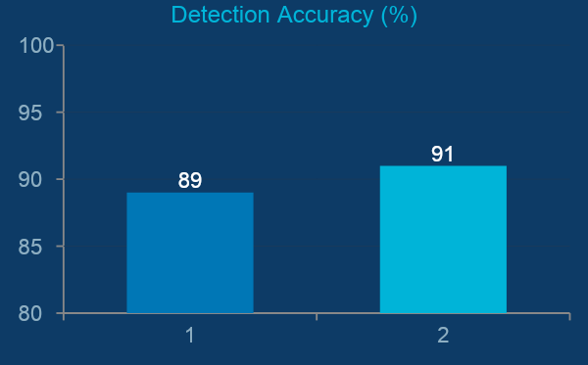
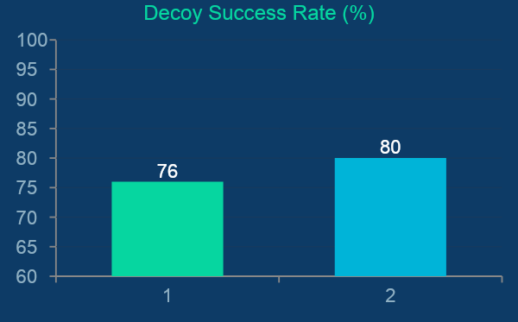
4. Experiments & Implementation — Results
99%
91%
2
<2s
SSRF Recall Rate
Recon Accuracy
Attack Types
Detected
Detection Latency
Notes:
The model now handles 2 attack types. SSRF recall is 99%, Reconnaissance accuracy is 91%. Decoy success: 76% for SSRF, 80% for Recon.

Slide 9
4. Implementation Steps
Phase 1 — Infrastructure
Multi-node KIND cluster with namespaced isolation • PV + PVC shared storage for real-time data exchange • Sniffer pod capturing traffic via tcpdump / KSniff
Phase 2 — AI Detection (upgraded: 1 → 2 attack types)
CICFlowMeter extracts 80+ features every 5 seconds • Naive Bayes model — now classifies: Benign / SSRF / Reconnaissance • Deployed as Flask API via KServe inside the cluster
Phase 3 — Deception via Mutation Webhook (upgraded: Controller → Webhook)
KubeDeceive Mutation Webhook intercepts K8s API requests in-flight • Go server applies: reject / delay / redirect logic without polling • Honeypot + audit logs + Streamlit real-time dashboard
Phase 4 — Optimization
Direct kubectl cp extraction bypassing PVC lag (2s refresh) • Stress-tested with both SSRF and Reconnaissance attack simulations
Notes:
Phases 2 and 3 were upgraded. Phase 2: model now detects 2 attacks. Phase 3: Python controller replaced by Mutation Webhook.

Slide 10
5. Problems Faced & Limitations
RBAC Permission Denied (403)
30-Second PVC Sync Lag
⚠ Security controller blocked from patching Kubernetes services — no write access by default.
⚠ CSV data from CICFlowMeter trapped in pod's isolated filesystem — 10–30s delay.
✓ Created Service Account + Role + RoleBinding granting only 'patch/update' on Services.
✓ Built direct extraction layer using kubectl cp in a loop every 2 seconds — bypassed PVC lag.
False Positive Rate (~34%)
Reconnaissance vs. Benign Overlap
⚠ Naive Bayes generates false positives on benign traffic resembling SSRF/Recon patterns.
⚠ Recon traffic closely resembles normal scanning, causing higher FP rate (6.5%) for this class.
✓ Accepted trade-off — FPs safely redirect to honeypot (Zero Trust). Recall prioritized over precision.
✓ Fine-tuned feature selection; planning threshold adjustment per class in future iterations.
Notes:
Fourth problem is now specific to Reconnaissance detection — it overlaps with normal scanning, which is harder to distinguish.

Slide 11
6. Demo / System Evaluation
Live Attack Simulation Flow
1
2
3
4
5
6
Attacker launches
SSRF or Recon
traffic
→
KSniff captures
packets → PCAP
stored in PV
→
CICFlowMeter
extracts 80+
features → CSV
→
AI Model
3-class output:
SSRF/Recon/OK
→
Mutation
Webhook
redirects traffic
→
Attacker trapped
in honeypot
logged + analyzed
Evaluation Results — 2 Attack Types
Metric | SSRF | Reconnaissance | Avg / Combined
Detection Accuracy | 89% | 91% | 90%
Recall Rate | 99% | 89% | 94%
False Positive Rate | 4.8% | 6.5% | 5.5%
Detection Latency | 0.8s | 1.2s | ~1s
Decoy Success Rate | 76% | 80% | 78%
Avg Engagement Time | 470s | 495s | ~482s
Notes:
Demo: fire an SSRF then a Reconnaissance attack. The webhook intercepts and redirects both to the honeypot within 2 seconds.

Slide 12
7. Conclusion & Lessons Learned
Key Achievements
Lessons Learned
✓ End-to-end automated defense system in Kubernetes
→ Webhooks > Controllers — event-driven beats polling
AI model detects 2 attack types: SSRF + Reconnaissance
→ Multi-class detection is more realistic than binary
→ Recall > Precision — missed attacks cost more
✓ 99% SSRF recall — near-zero missed attacks
→ Deception + detection together outperform either alone
91% Reconnaissance detection accuracy
Future Work
Mutation Webhook replaces controller — faster & event-driven
→ Expand to more attack classes (privilege escalation, DoS)
✓ Real-time Streamlit monitoring dashboard
→ Automated model retraining pipeline
✓ Full RBAC-secured pipeline with audit logs
→ SIEM integration (Splunk / Elastic)
→ Zero-day detection with autoencoders
Notes:
The two upgrades — Webhook and 2-attack model — are the headline achievements of this final seminar.

Slide 13
Thank You
Notes:
Open for questions and live demo.

